Slide 1
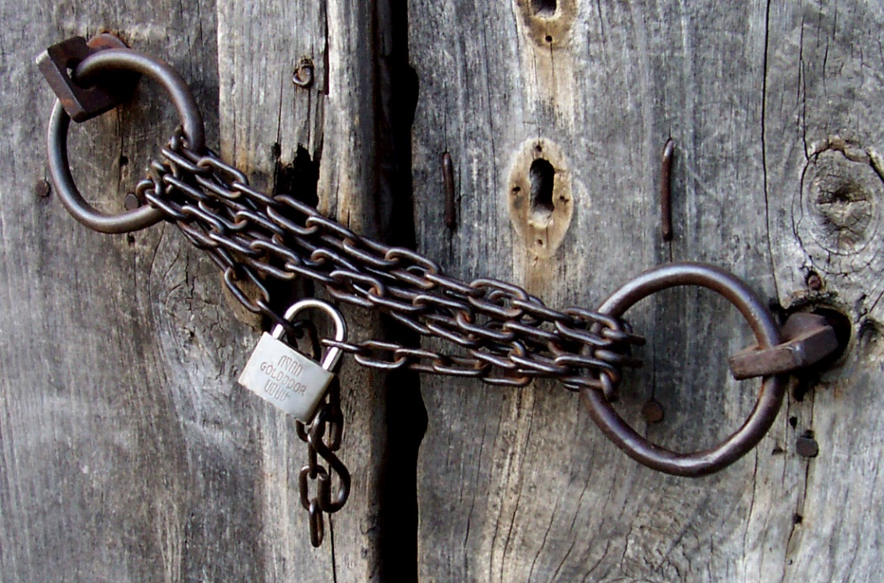
The Power of Secrets
Sarah Withee
Slides: geekygirlsarah.com/secrets
Twitter: @geekygirlsarah Feel free to tweet along.
Notes:
Good afternoon everyone. I want to thank you all for being here today.
[PAUSE]
Please close your eyes for a moment.

Slide 2
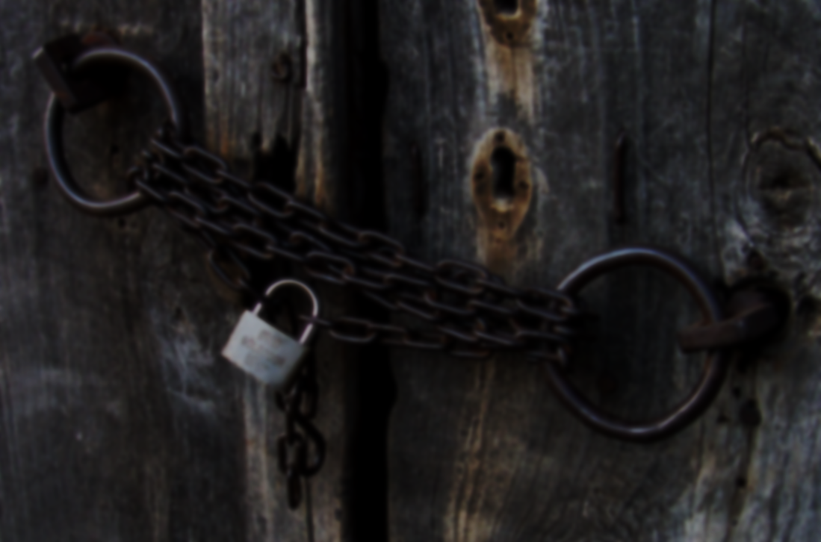
Notes:
Imagine you're with the person who is your best friend or closest friend. [PAUSE] Maybe you’re with them in person, maybe online. Whatever your situation typically is when you’re with this person. [PAUSE] Now imagine you told them one of your biggest secrets. Not like “I pick my nose” kind of secrets, but something truly deep. [PAUSE] Do they seem comfortable knowing this? [PAUSE] Do you feel like they're judging you? [PAUSE] Are YOU comfortable having just said it? [PAUSE] Now imagine it's a coworker instead. [PAUSE] How do you feel now? [PAUSE] What about your manager at work? [PAUSE] Your barista at a coffeeshop? [PAUSE] Are you still comfortable in these situations? [PAUSE] Do you feel you COULD share this secret with these people? [PAUSE] Alright, open your eyes. [PAUSE] Look to your neighbor. [PAUSE] If I asked you to share something with your neighbor, could you do it?

Slide 3
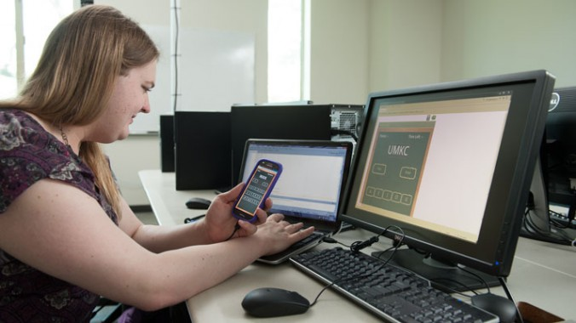
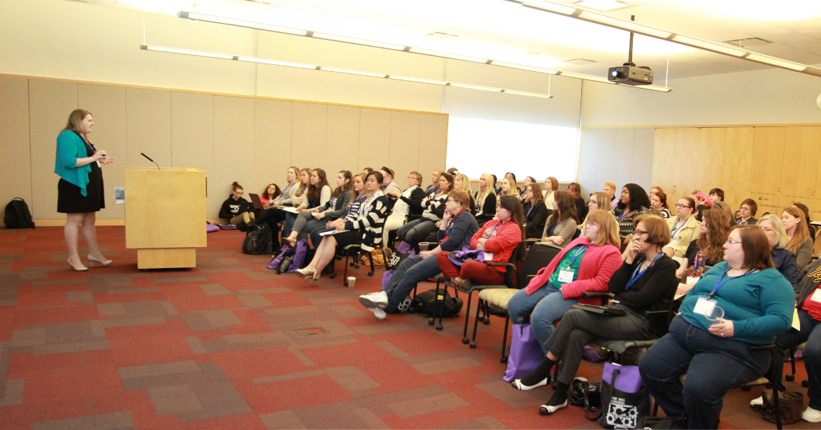
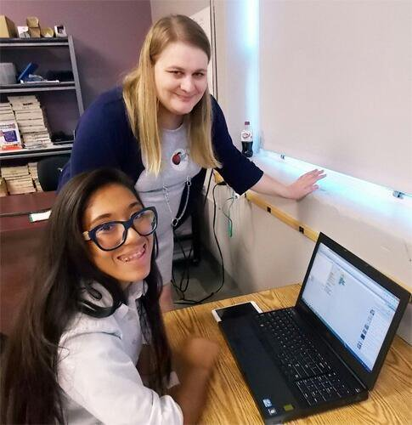
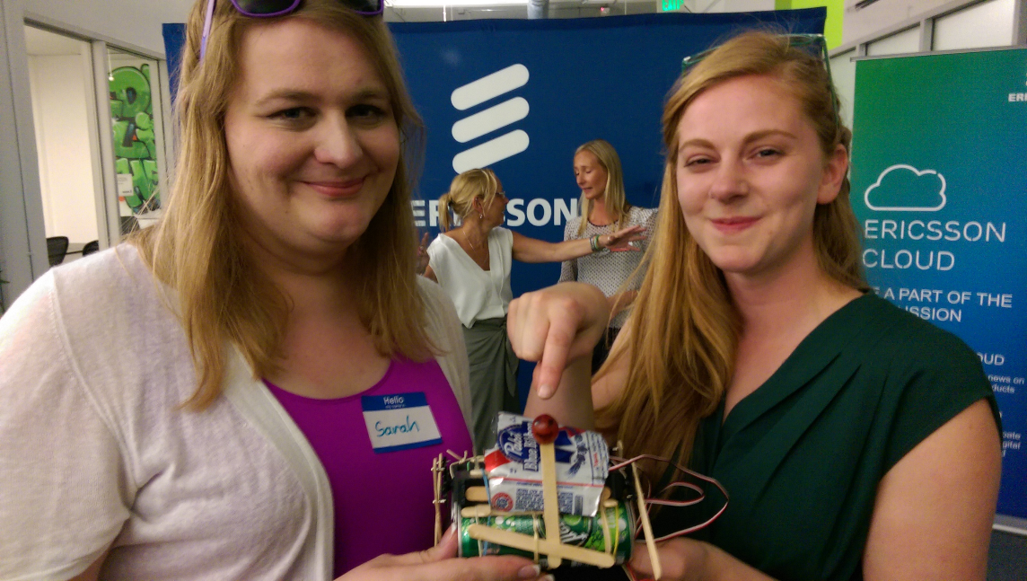
Hi. I’m Sarah.
@geekygirlsarah #alterconf
Notes:
Hi. I'm Sarah Withee, I'm a software engineer, a conference speaker, a teacher and mentor, and I’m a hardware and robotics tinkerer. (And if you’re wondering, yes, that IS shitty robot builder Simone Giertz holding a shitty robot I helped built.) I typically use these as descriptors. But…

Slide 4
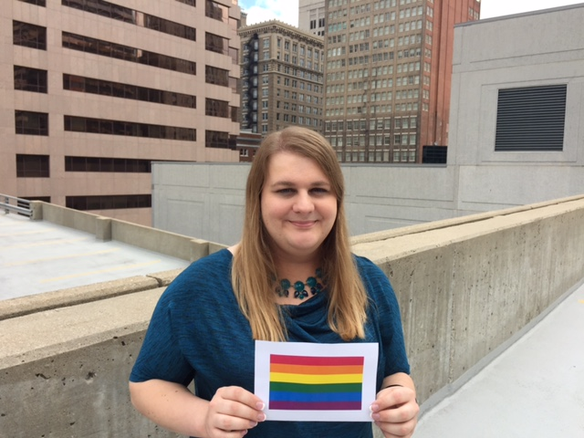
@geekygirlsarah #alterconf
Notes:
I'm also transgender, or trans for short.
[IF OTHERS HAVE SPOKEN] I know it’s been explained today but I want again to explain for the recording.
[IF NOT] So let me explain what term this means real quick.
A person is transgender when their body’s sex doesn’t match up with their view of their mental or internal gender. Studies have shown that gender really can be quite fluid and not just “man” or “woman”, and that bodies don’t even really fit into this either-or system all the time. There’s lots more research out there now than when I was kid. If you haven’t, I really recommend learning about it. It’s more and more likely you’ll run into a trans person at some point.
Anyway, for me, this meant that I was a woman but wasn’t born in a female body.

Slide 5
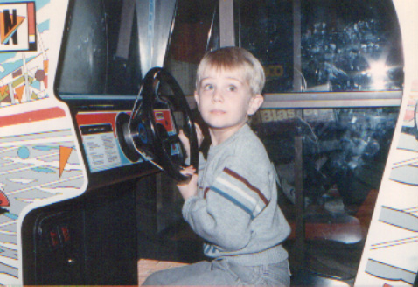
@geekygirlsarah #alterconf
Notes:
This is a picture of me when I was young. Obviously don’t look much like a little girl. I was still cute though, right? I was playing Pole Position at an arcade for my birthday party. I still think it’s a great game.
Anyway, the parts of my story you’ll hear today are NOT the same issues every trans person will have, but probably will be similar to many people.
[WATER]

Slide 6
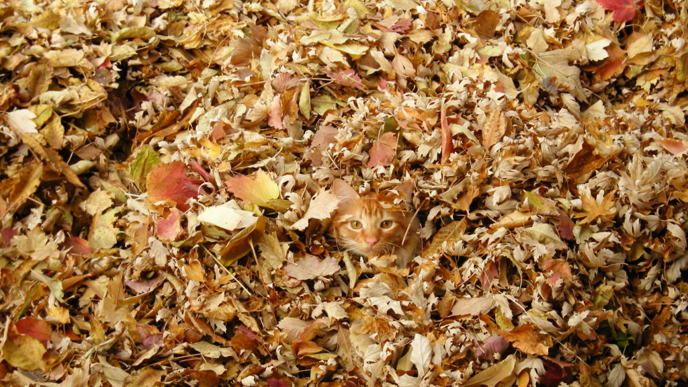
Being Stealth
@geekygirlsarah #alterconf
Notes:
I want to start off talking about being “stealth.”
Trans people refer to being “stealth” when they blend into their communities and people don’t know they’re trans. [PAUSE]
When I first transitioned in 2007, I was involved in the LGBTQ community in Kansas City. I was also very visibly trans, especially from having changed my appearance, name, and all that other stuff. I had dropped out of college from depression and gender issues, and in 2011 I was ready to go back. That first semester of school, I joined 3 engineering organizations and the LGBTQ one. Very quickly I got super busy and became a leader in 2 of the engineering groups, and the LGBTQ one fell to the side. Also I went back to school as a woman, as Sarah, so no one really knew about my background. I ended up going stealth. [PAUSE] It felt good to be stealth. I was around so many people that just saw me as me… as Sarah. I didn’t need to tell anyone. And I was doing great in school. [PAUSE] But things slowly got more difficult as the years passed. I was making new friends, good friends. I found stories of my past had to be rewritten, like “When I was a little boy” had to change to “when I was a little kid”. Some parts of my past were just easier left out. Friends knew my parents disowned me, but I usually ended up just saying this was from political belief differences. At times, I felt like I was dismissing 24 years of my life. [WATER] The closer to graduation I got, the more geek communities I found myself in. Slack showed up, I got more involved on Twitter, and I started speaking at conferences. I slowly met more LGBTQ people in tech. [PAUSE] And slowly I started seeing these communities merging together.

Slide 7
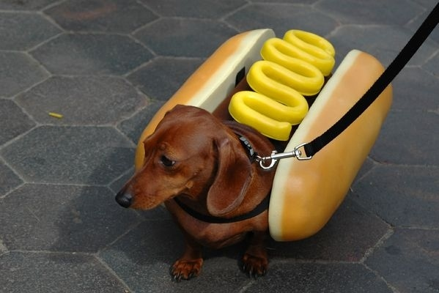
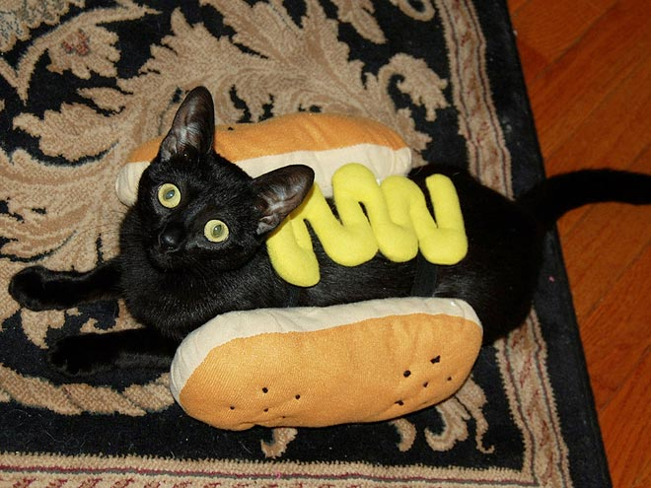
@geekygirlsarah #alterconf
Notes:
While I felt like being stealth the world saw me as I wanted them to see me…
[CLICK]
… I felt a bit fake. Like I was hiding too much. I wasn’t authentic. And people would find out. Someone would out me somewhere. And I hated this idea. [PAUSE] I knew I had to come out before someone outed me. [PAUSE] Twitter felt too… passé. Besides it’d probably be easily skipped in the midst of timefeeds and such. I decided I should write a blog post instead.

Slide 8
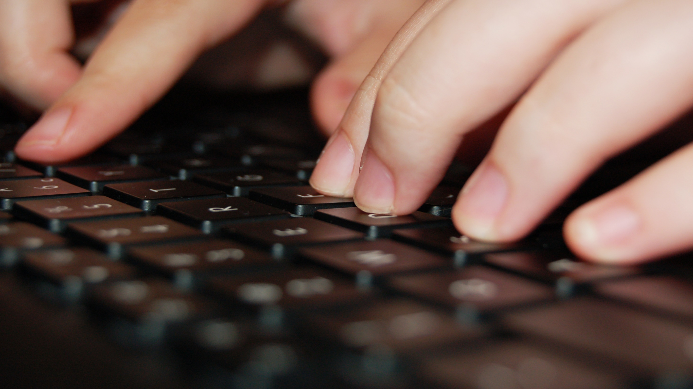
The Blog Post
@geekygirlsarah #alterconf
Notes:
[PAUSE] I didn’t want to say “Hi, my name is Sarah. I’m trans. Have a good day.” I wanted to do something empowering with this. I wanted to help people, encourage people, share a great story they could relate to, even if they weren’t trans or LGBTQ.
I knew several people have told me in the past they thought I was brave or courageous for transitioning. [PAUSE] What if I took the post this direction? I could talk about my story from how I wanted to be a developer, the gender issues and depression held me back, but I fought it and won! [PAUSE] I decided Medium.com would be good, since I’d get a good audience from it. I started writing it out. I sent the draft to a couple of friends, they offered some suggestions, and I modified it. I did 7 revisions in the end, and had a ton of reviewers. I even asked on Twitter for the last one, and a total stranger responded. Leigh Honeywell from Slack offered to help. We followed each other, but never chatted before, so this was probably the most awkward reviewing session ever. But she had such great constructive suggestions. [PAUSE] I kept just making small changes to an already great post, so I finally made a deadline: Tuesday, September 29th. I wrote out the tweets I was going to post in a text editor. I was going to hit Publish on Medium. And it was going to be done. [WATER]

Slide 9
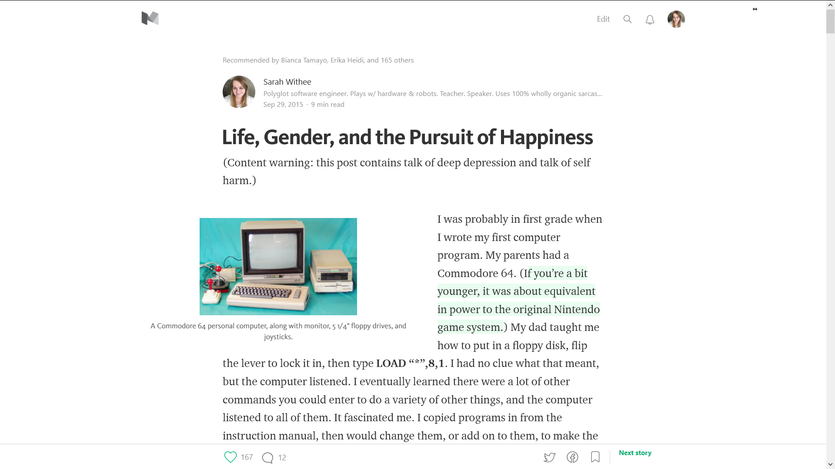
@geekygirlsarah #alterconf
Notes:
Tuesday came. I wanted to do this during the day so more people would see it. So that afternoon I hit Publish on my post. It went live.

Slide 10
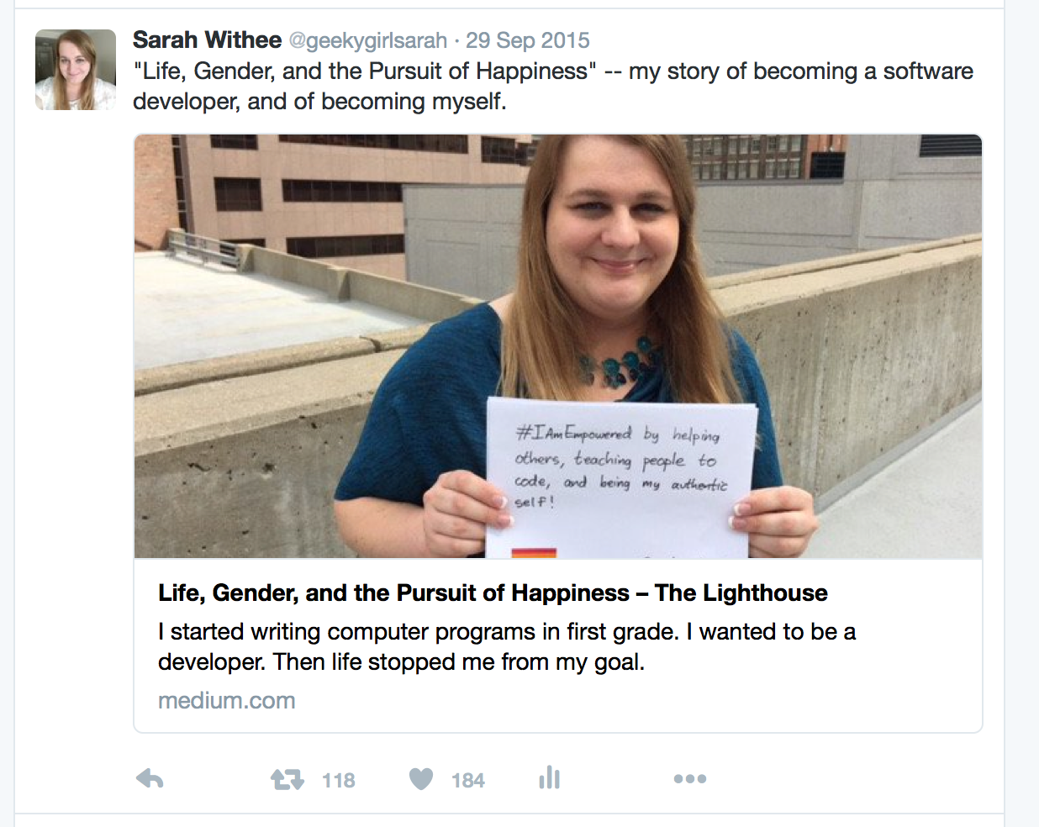
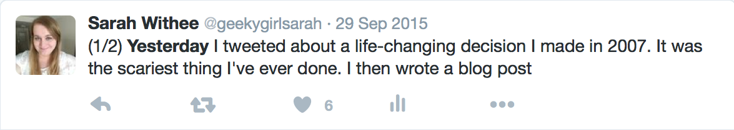
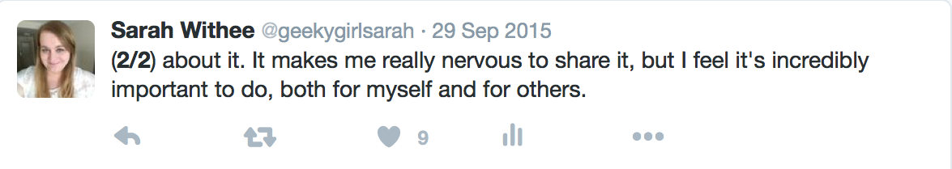
@geekygirlsarah #alterconf
Notes:
I copied and pasted my tweets from my text editor into Twitter.
And in the few seconds it took to do this… My heart SANK into my stomach. I shouldn’t be doing this. I made a mistake. I shouldn’t come out. Oh geeeeeeeezzzzzz.
I had already started, so I finished the tweets, then grabbed my phone and ran to the restroom at work…

Slide 11
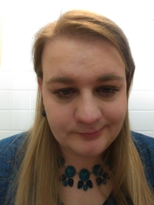
@geekygirlsarah #alterconf
Notes:
I ran into a stall. I was sobbing and shaking and holding my phone and I didn’t know what to do. [PAUSE] I opened up the LGBTQ in Tech slack. And I went to the #mental_health channel. I typed “Someone please tell me I didn’t just ruin my life.” [PAUSE] Many reassured me that I hadn’t. And I don’t know why, but I took this picture and uploaded it in there. [PAUSE] My coworker at the time, Katie, tracked me down, and after 45 minutes I quit crying and shaking. I wiped off my face, and went with her to a coffee shop. She chatted with me for a bit. She calmed me down. And all the while, my phone was buzzing. Repeatedly. Nearly nonstop for a bit. Likes. Retweets. Recommendations. It was all happening so fast. [PAUSE] It was hoping maybe to 50-100 would see this post in the end. Mostly real life friends, maybe some others…

Slide 12
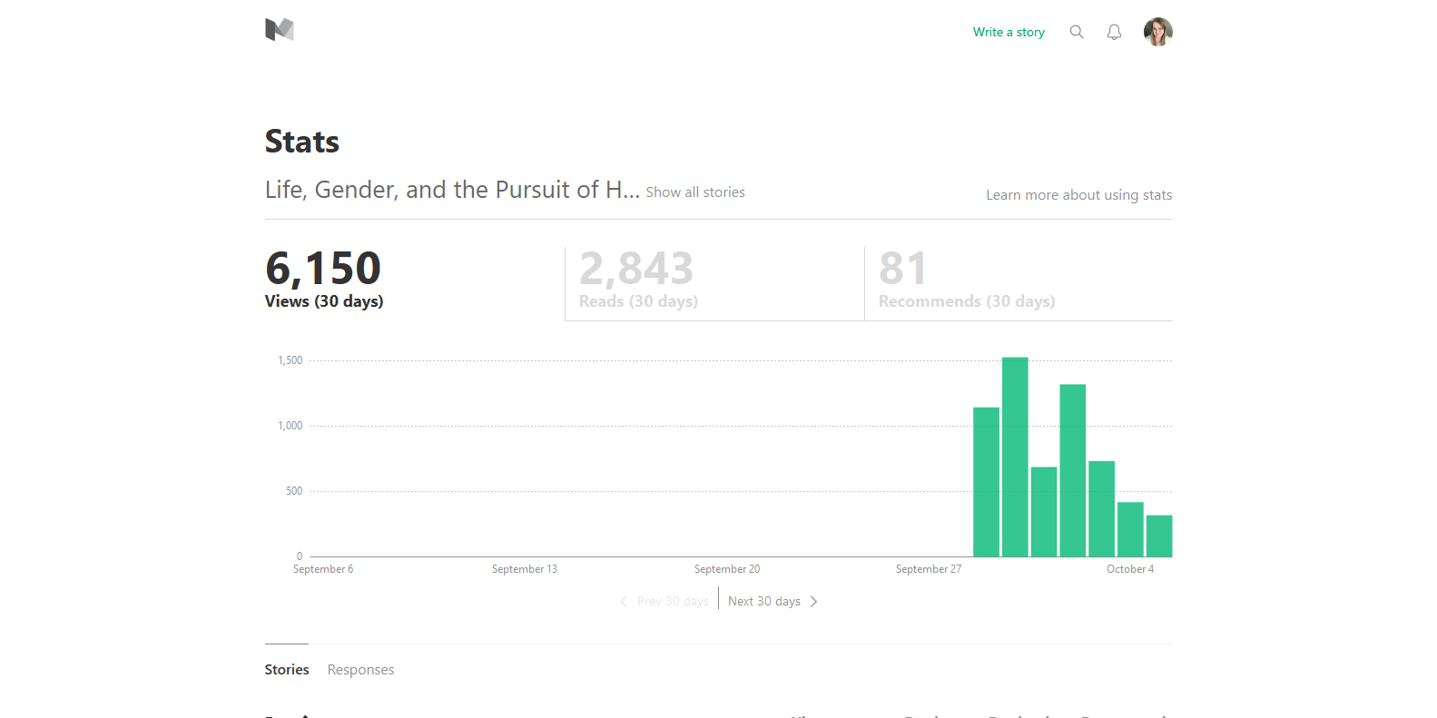
@geekygirlsarah #alterconf
Notes:
Within the first day over a thousand people had seen this. Within the first 3 days, about 3,000 had seen this. And by the end of the week, as you can see, 6,000. I didn’t even know this was a real possibility. How could something I have done get this much attention? And so fast? [WATER]

Slide 13

@geekygirlsarah #alterconf
Notes:
But… I was out. [PAUSE] For the first time in 8 years after transitioning… I was publicly out of the closet. And I knew I couldn’t go back in. [WATER]
I had some fears about coming out publicly. I might lose friends. Maybe I might jeopardize current or future jobs. I might jeopardize the conference speaking I was doing. I mean… I knew trans people who came out and it was fine, but they were along the coasts. I live in the Midwest! And what if my friends, who just thought of me as a woman, now thought of me like a fake woman, or their image of my has been tarnished somehow?

Slide 14
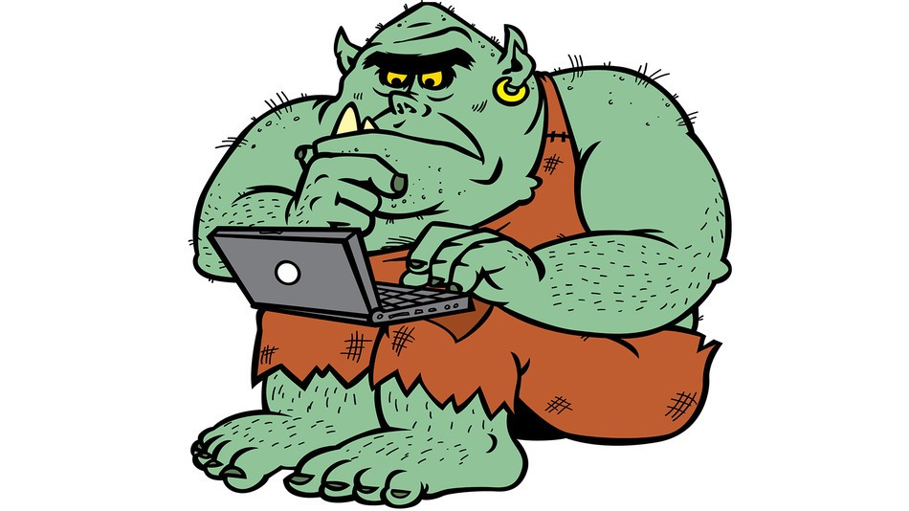
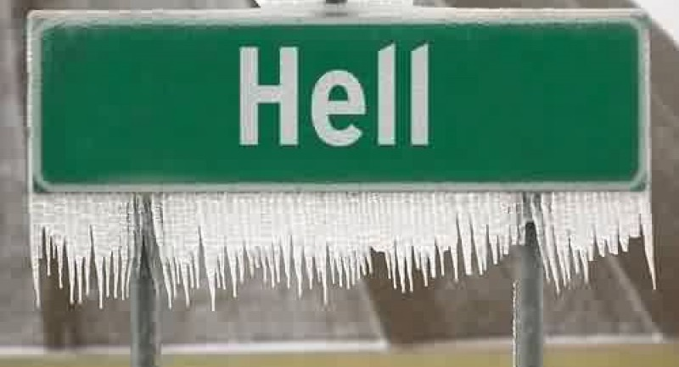
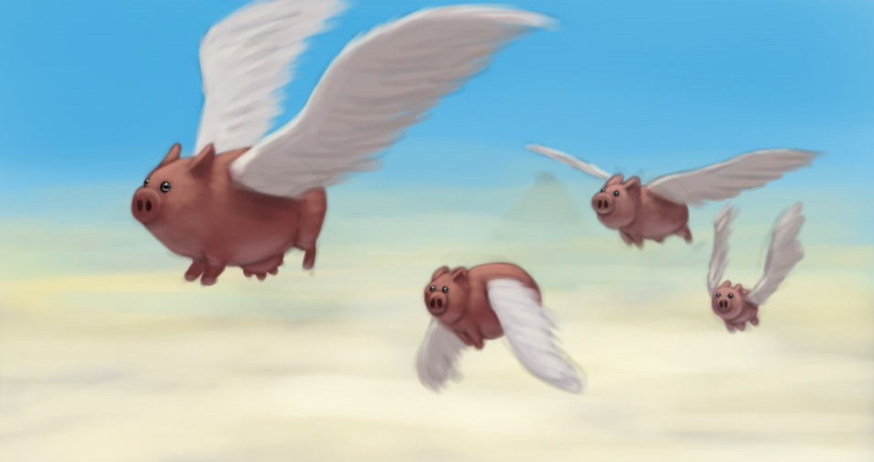
@geekygirlsarah #alterconf
Notes:
What if this started an attack of internet trolls coming after me? What if hell froze over? What if pigs started flying!?!?

Slide 15
@geekygirlsarah #alterconf
❌
❌
❌
Notes:
So… that didn’t happen. (Probably no surprise.)

Slide 16
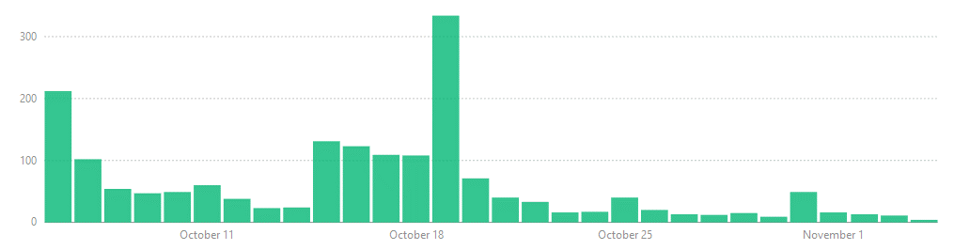
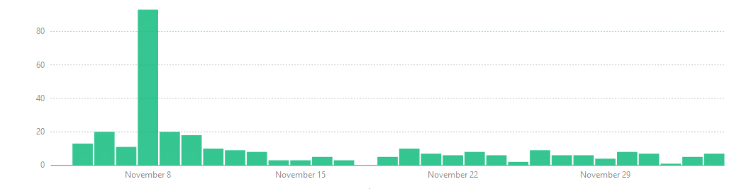
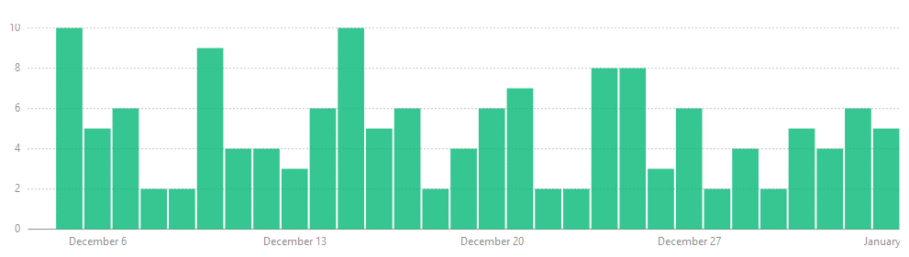
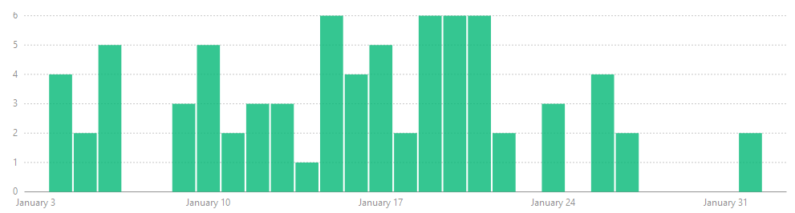
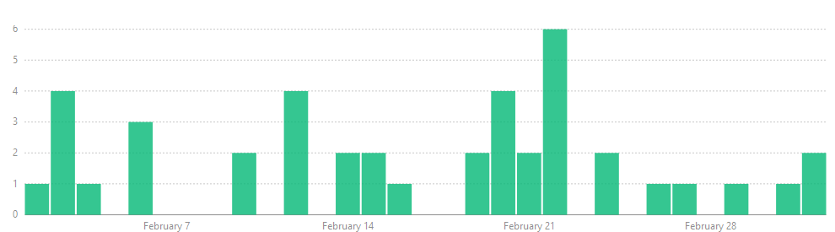
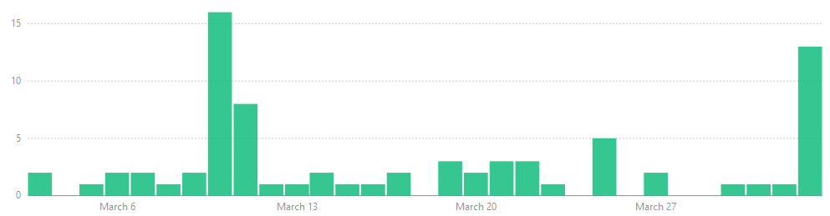
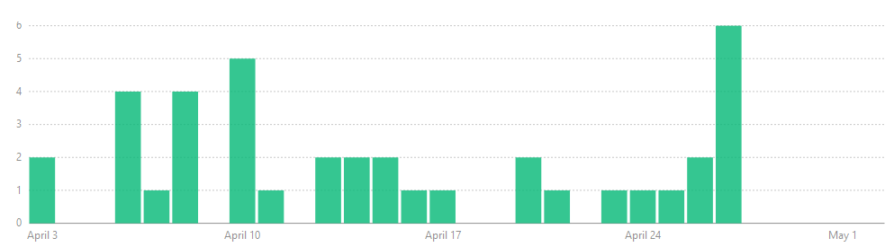
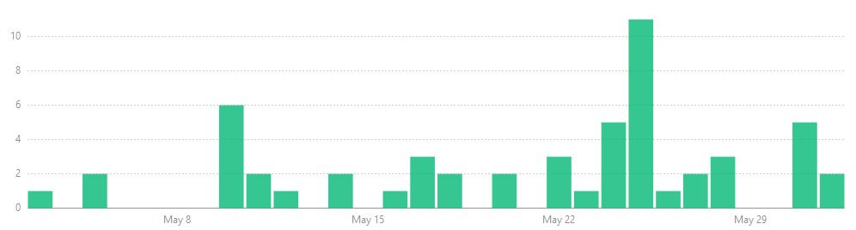
@geekygirlsarah #alterconf
Notes:
As I mentioned, thousands of people were looking at the post within days. But even as time went on, people kept looking. I kept getting recommendations to this post on Medium, as well as well as likes and retweets on Twitter. Every time I looked at how many emails I had or I looked at Medium’s stats, I was floored that this continued. People kept reading this. They kept sharing it. This slide shows 8 months of views. They decreased over time, but for the most part, some person read this post every day for a full year.. This became the most popular thing I had ever done.

Slide 17
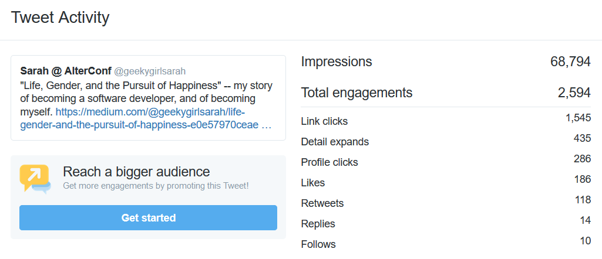
@geekygirlsarah #alterconf
Notes:
68,000 people have seen this tweet in one year.

Slide 18
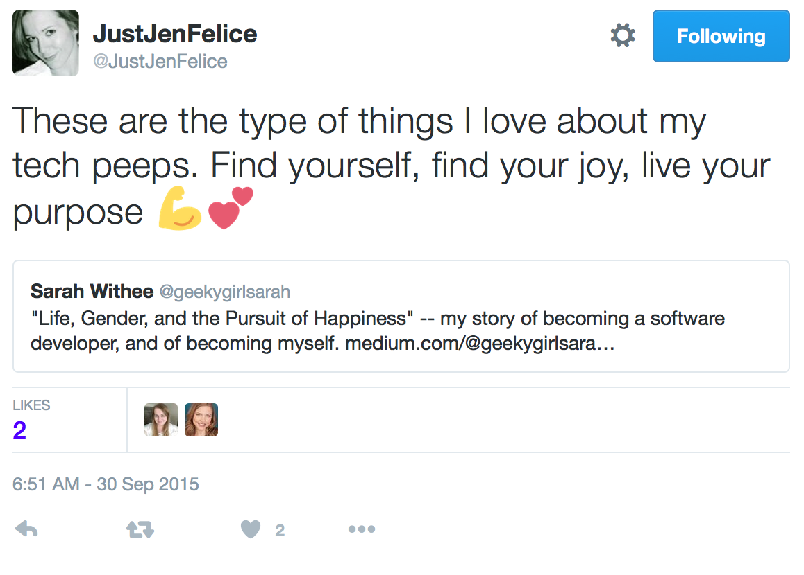
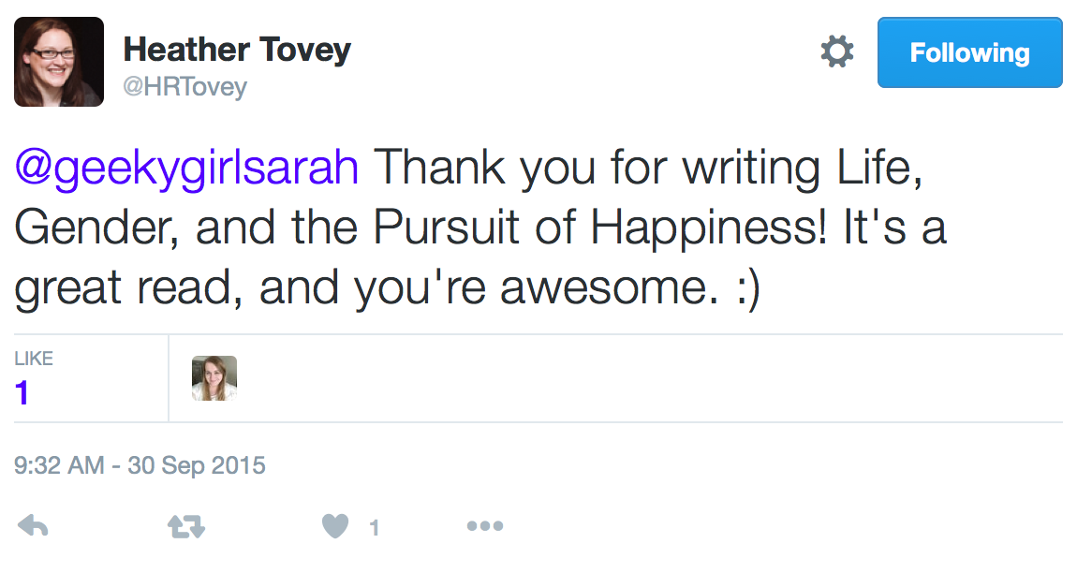
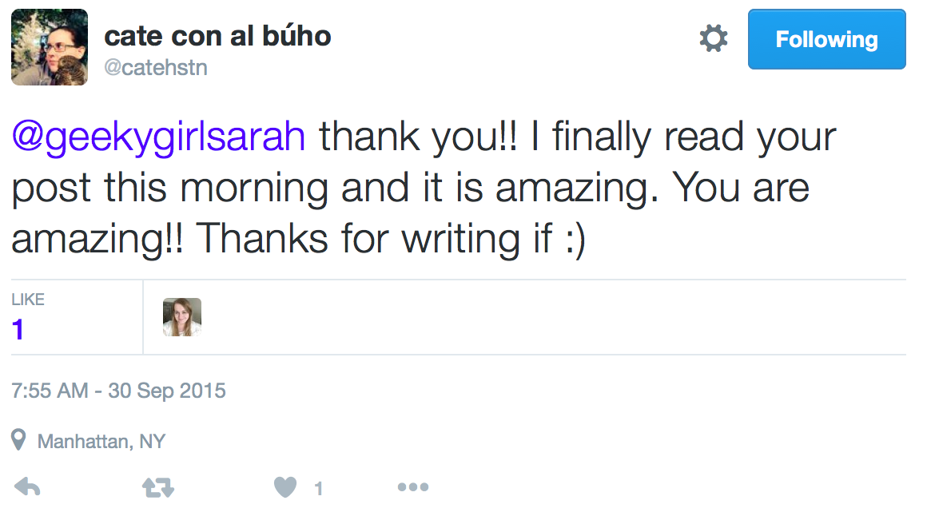
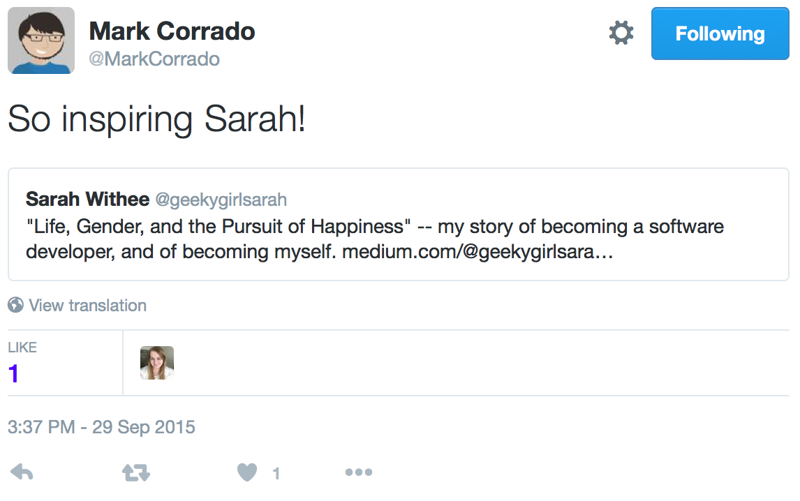
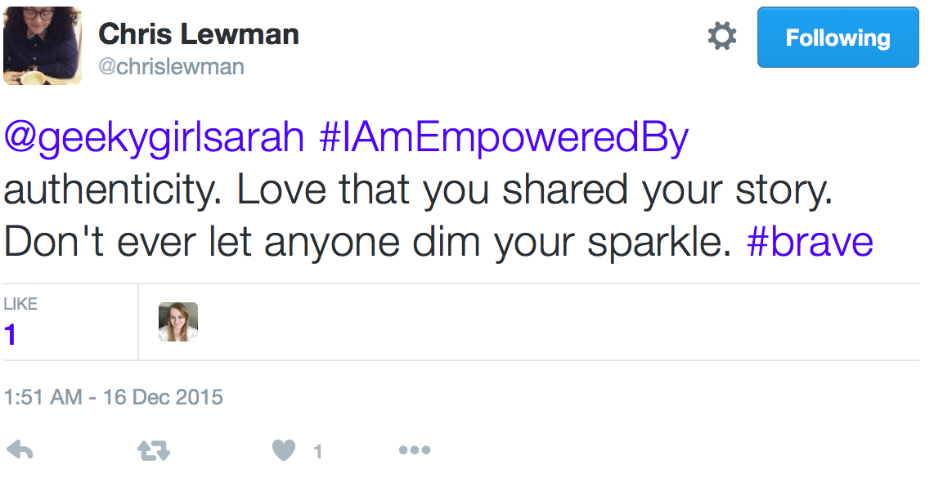
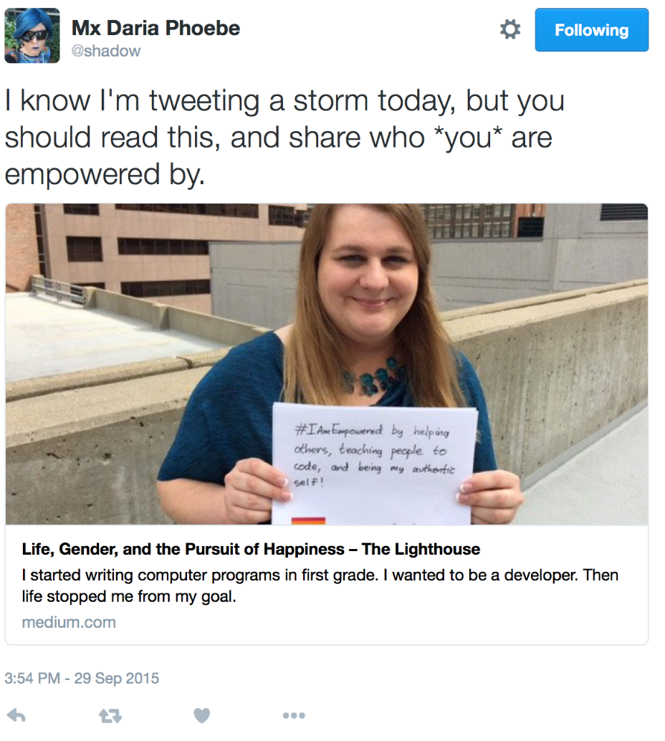
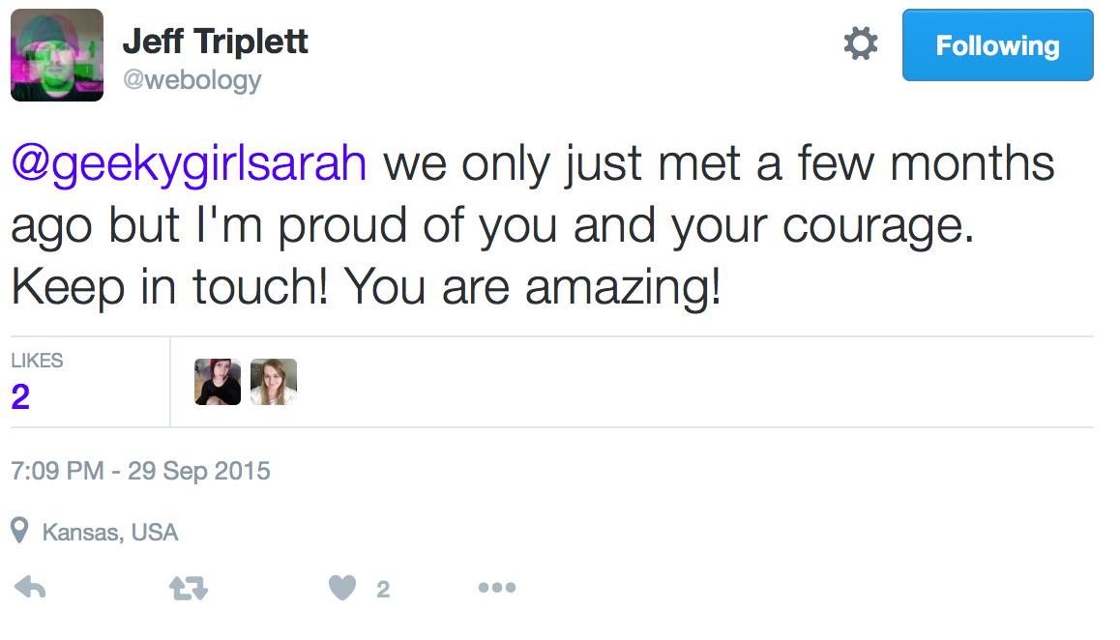
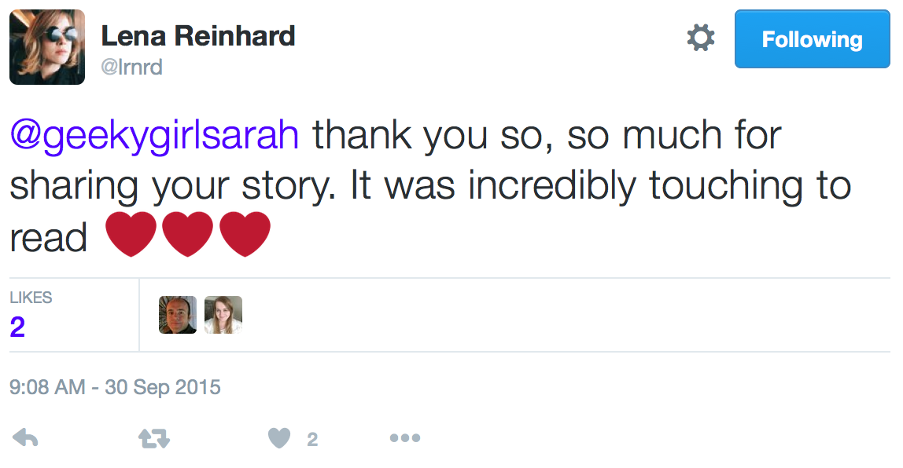
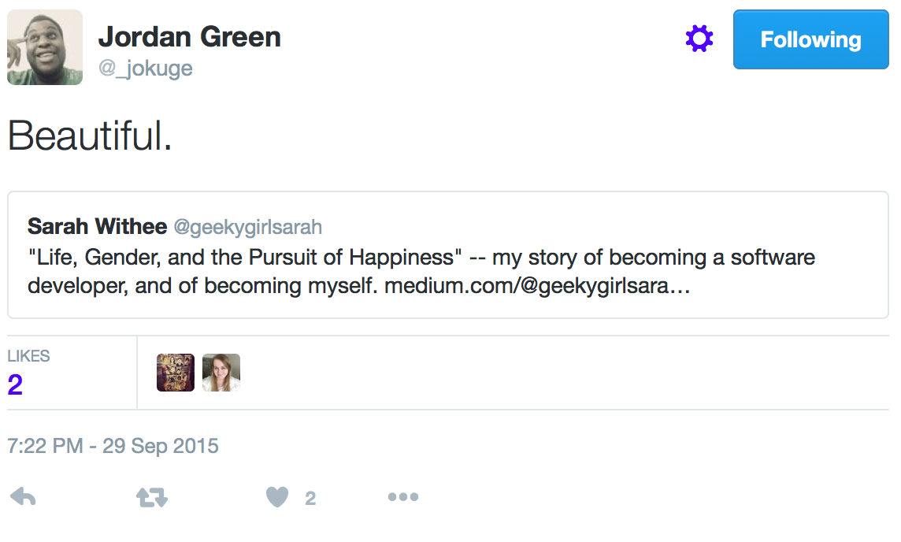
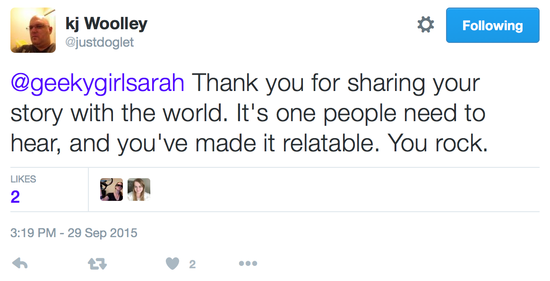
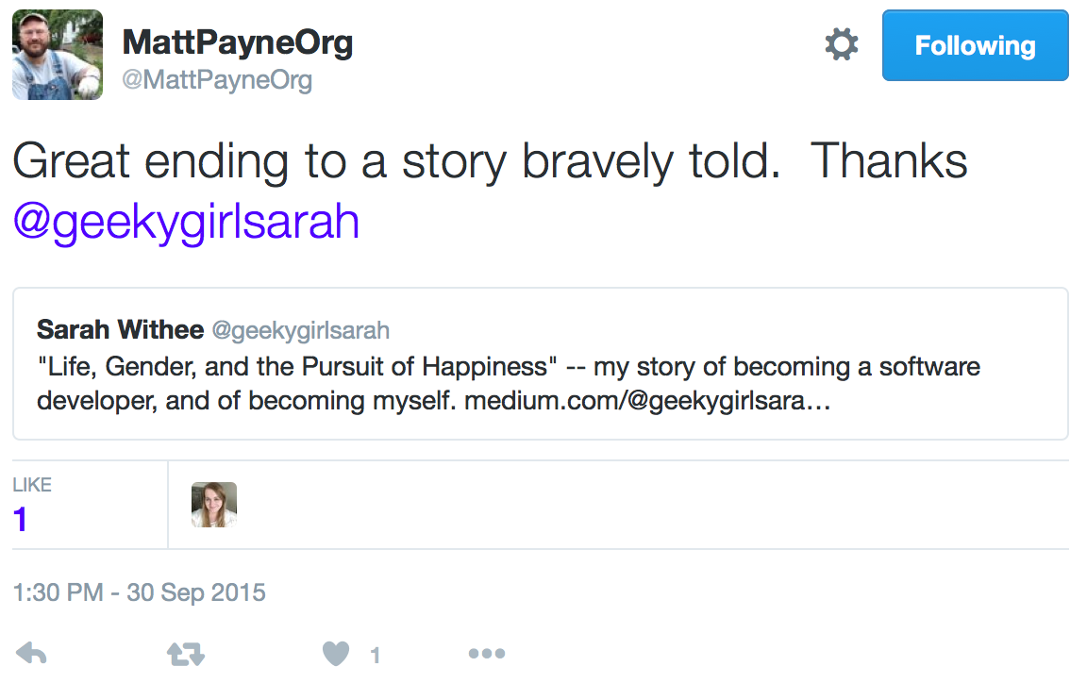
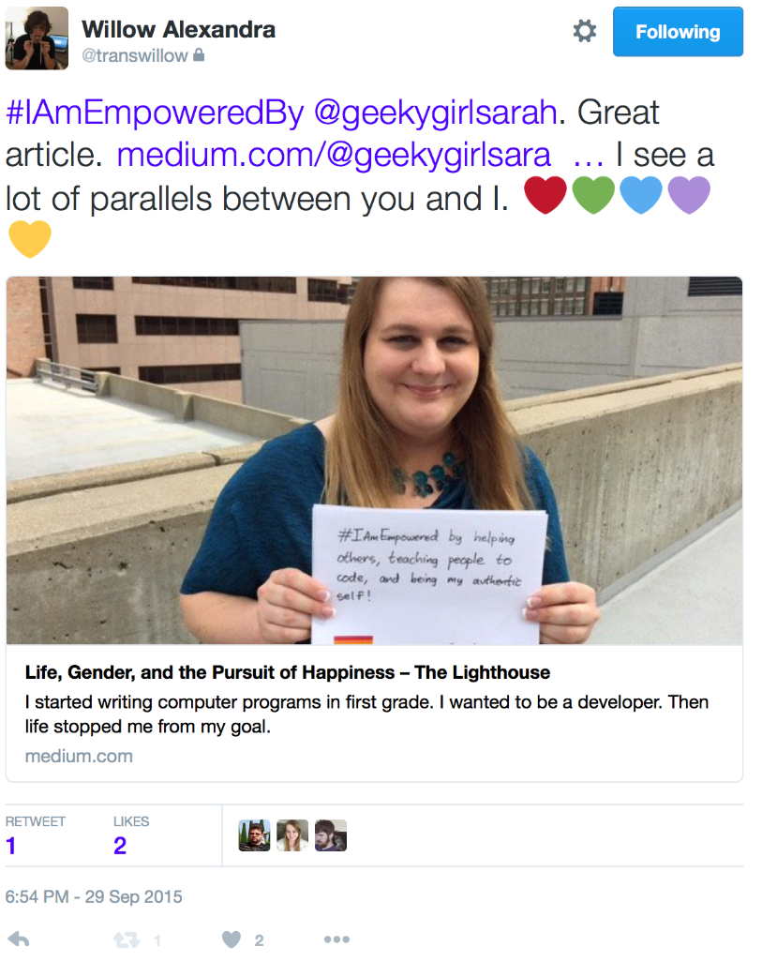
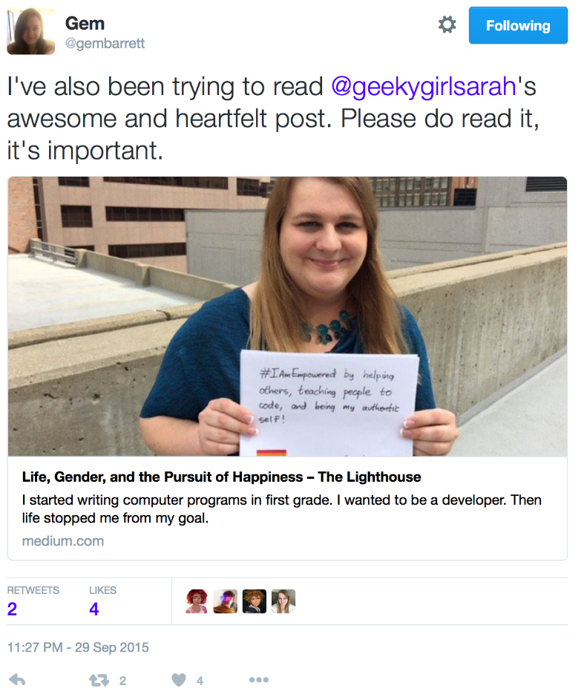
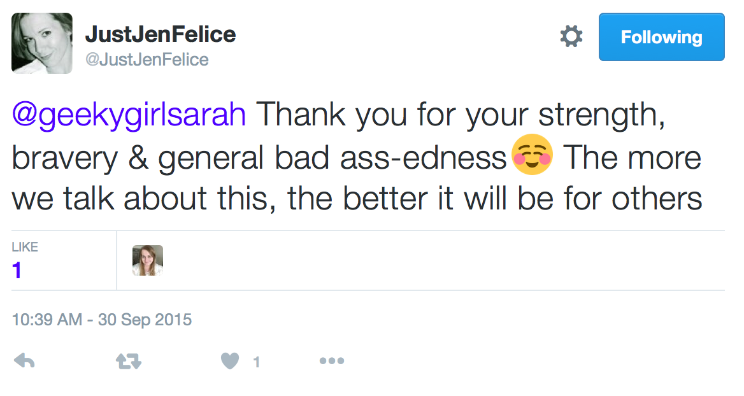
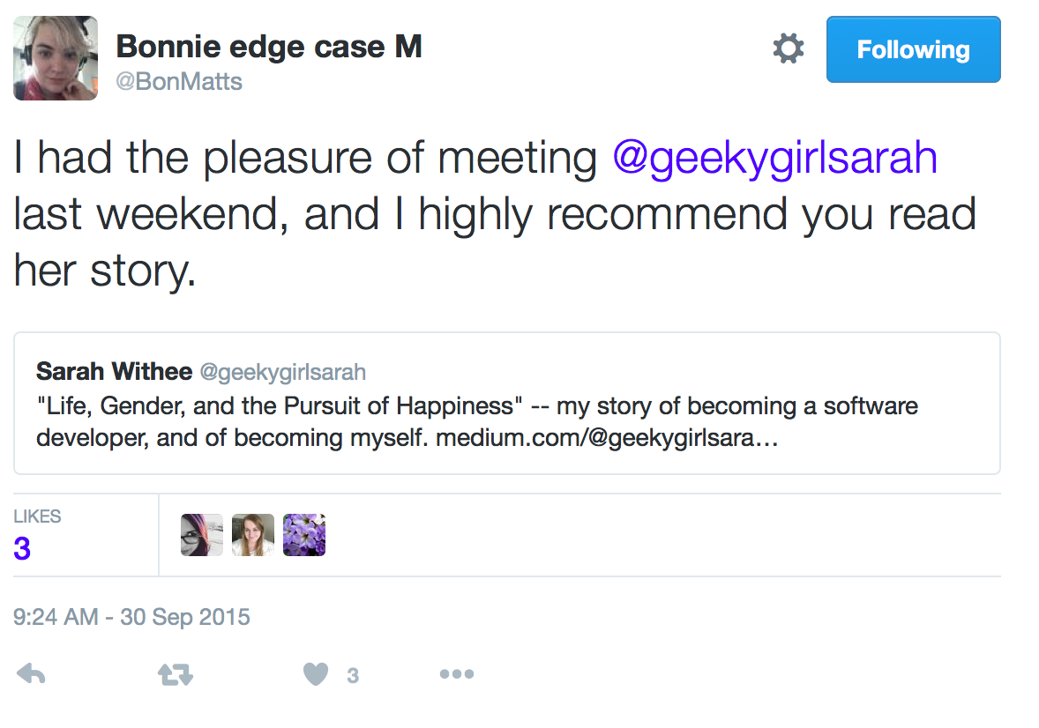
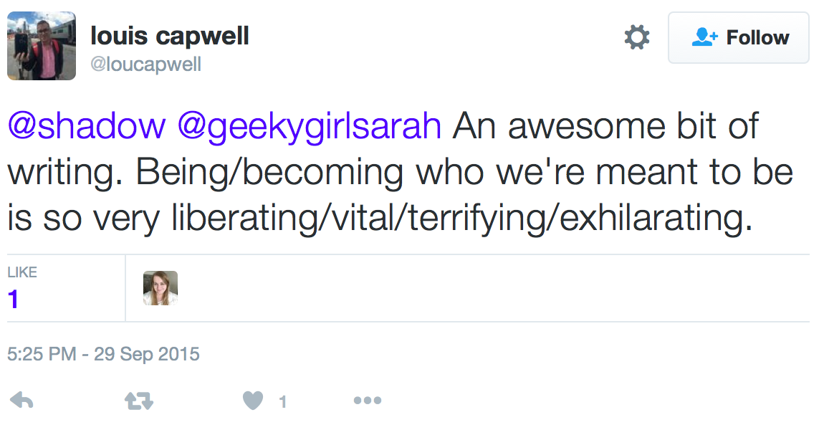
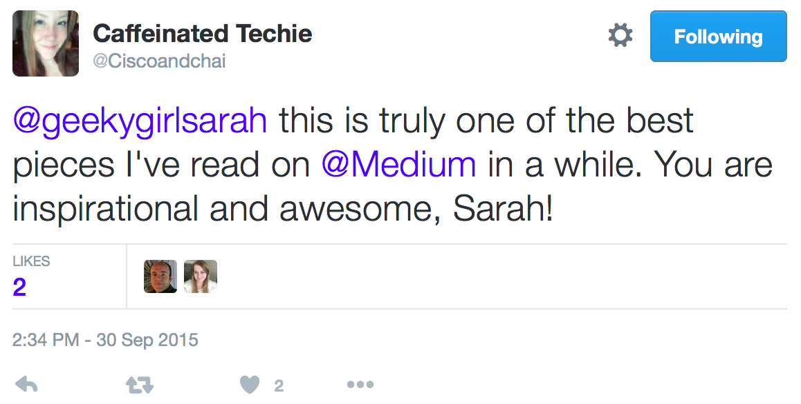
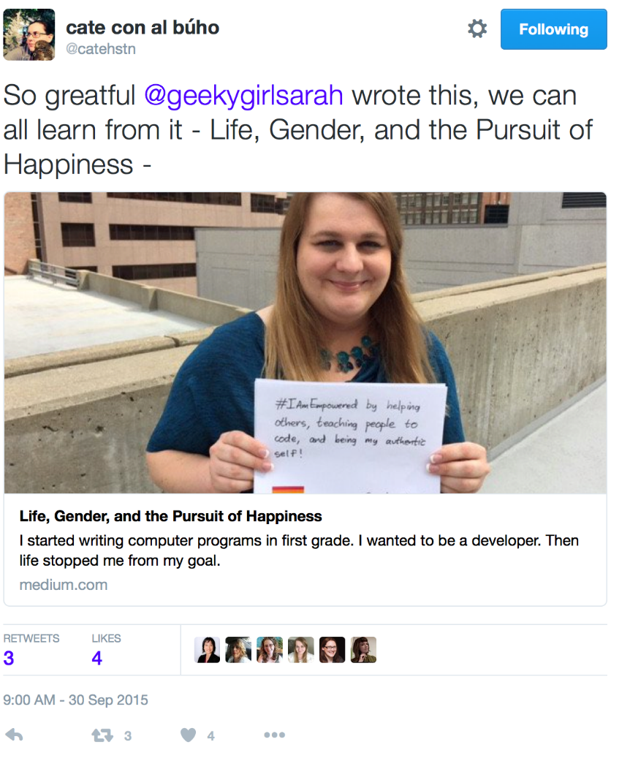
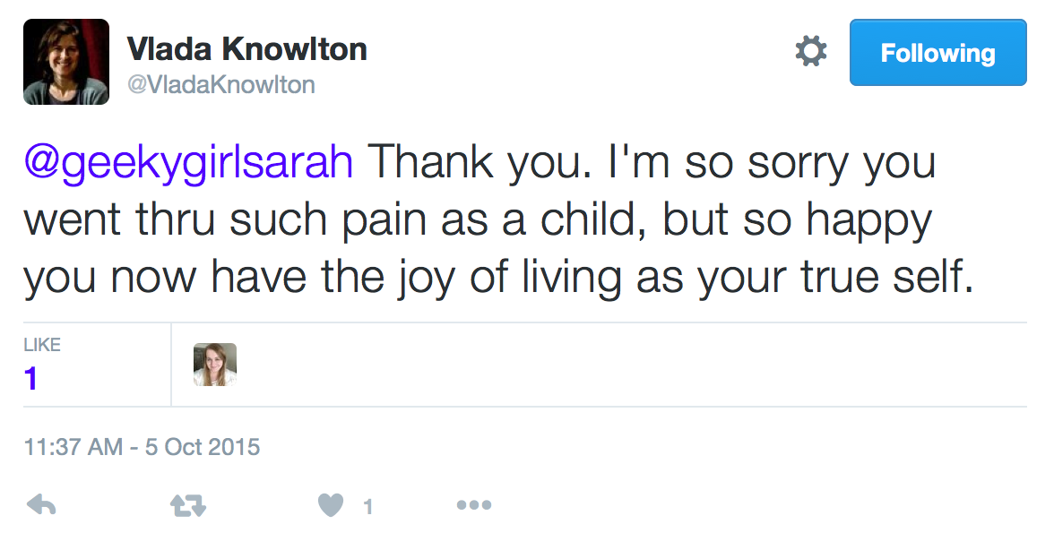
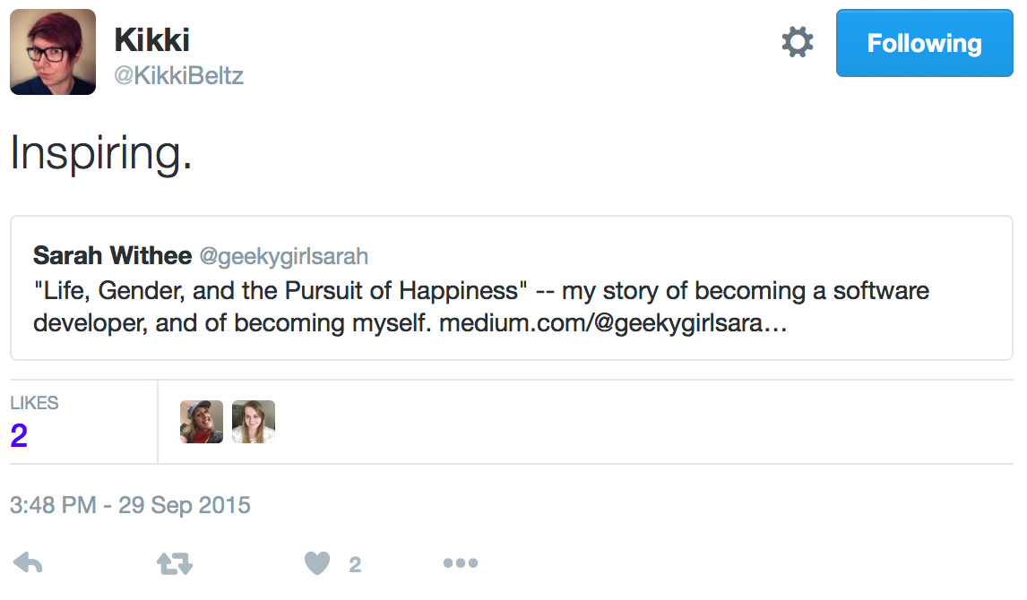










@geekygirlsarah #alterconf
Notes:
What else happened? People started messaging me. First one… then another… then another… and it didn’t seem to stop. They thanked me, told me this post was brave or courageous, they called it beautiful and inspirational. They said it was a must read. And so many more great things…

Slide 19

@geekygirlsarah #alterconf
Notes:
… they came out to me (sometimes already out, sometimes not)… [READ]

Slide 20

@geekygirlsarah #alterconf

Slide 21

@geekygirlsarah #alterconf
Notes:
… they told me how they related to my depression struggles, or some giant hurdle to overcome in their life to be successful, or some other way they connected with this story…
… people even went out of their way to anonymously send me messages to not out themselves, but still tell me how they loved my post. This person works at a large, big name company you all have heard of. [READ]

Slide 22

@geekygirlsarah #alterconf
Notes:
People were doing the exact opposite thing of what I feared. I had 100% positive things happen from this. Current friends told me they read it and it was great. I made more friends. Other conference speakers told me they saw this, including some very big names.

Slide 23

@geekygirlsarah #alterconf
Notes:
And Anil Dash, among others, even retweeted this.

Slide 24

@geekygirlsarah #alterconf
Notes:
One year later I still hear from others about my post. The stats above I took at the airport yesterday. The spike at the end was me tweeting about the 1 year anniversary but… it’s still got reads nearly every day this month. I still am surprised when I get another message from it. How did this story ever come to affect SO many people? [PAUSE] As they shared more stories with me, I slowly felt this weight come off my shoulders. I still have my scary feelings, but it was way more amazing than I ever dreamed during the months I was writing this out. [PAUSE] So why did I just tell that really long story about a blog post? It’s because I’ve spent the past year reflecting on vulnerability.

Slide 25

On Becoming Vulnerable
@geekygirlsarah #alterconf
Notes:
How many of you think of vulnerability as a bad thing? [PAUSE] When we think about vulnerability, it’s usually not good. We tend to think about a person in a dark alley and what bad might happen to them.

Slide 26

@geekygirlsarah #alterconf
Notes:
Or basically any horror film ever where someone is in the woods and you know something’s going to attack them.

Slide 27






@geekygirlsarah #alterconf
Notes:
What if I told you that vulnerability is a good thing? [PAUSE] I think it’s the basis of great friendships. [PAUSE] Are you best friends with someone because of the weather, or because they have a cute pet, or they read the same book you do? Probably not. You’re likely best friends because you bonded over something vulnerable. Or some shared experience. Or just sharing important, deep experiences.

Slide 28

@geekygirlsarah #alterconf
Notes:
Brené Brown studies human connections. She set out to study some of them, and ended up spending years on her research. In her TEDx talk called “The Power of Vulnerability”, she said….

Slide 29

%
@geekygirlsarah #alterconf
“I know vulnerability is kind of the core of shame and fear and our struggle for worthiness, but it appears that it’s also the birthplace of joy, of creativity, of belonging, of love.”
- Brené Brown
“The Power of Vulnerability”
Notes:
[READ] I love this quote. [PAUSE] She’s right. Think about it: don’t you fear the unknown more than the known? [PAUSE] And are you really creative if you know the exact outcome?

Slide 30

@geekygirlsarah #alterconf
Notes:
Everyone’s favorite painter, Bob Ross, encourages great creativity. He likes to say…

Slide 31

@geekygirlsarah #alterconf
“There are no mistakes, just happy accidents.”
- Bob Ross
Notes:
[READ] He encourages you to try something new, even when you don’t know the result. But, even those mess-ups are still great. All of his episodes of The Joy of Painting are being put on Youtube. And you’ve probably seen at least one before. But go find one of them, and actually listen to him. He’s always encouraging the viewer to do something new and different, and never tells you how to “correct” it because your mistakes are still correct as they are. [WATER]

Slide 32

@geekygirlsarah #alterconf
Notes:
Vulnerability is what makes humanity real. [PAUSE] When was the last time you thought someone was so perfect, and you didn’t like them because you are too imperfect? If they told you all of the things going wrong in their life that you didn’t see, would you change your views of them? [PAUSE]

Slide 33

@geekygirlsarah #alterconf
Notes:
I won’t ask for any hands, but do you get road rage? When we think about a car cutting us off, or a car going slow, it’s an inconvenience to us. But what if you thought about the person behind the wheel. Were they being a jerk, or was there something going on that caused them to make the move they did? All of a sudden, maybe what was just a car being rude is now… a person. A real human. Maybe with problems.

Slide 34



@geekygirlsarah #alterconf
Notes:
Remember Post Secret? The site where you mailed in postcards with deep secrets and they were posted on the website anonymously? On the left is a screenshot of a few postcards from this week. On the right is a screenshot of the whole site from this week. There are 45 postcards. That’s just what he received last week and posted. And if you’ve read the site, how many of these have you felt sympathy for? How many of them have reminded you of your own stories?
When you learn people have flaws and faults, they become more real. More human. More capable of mistakes and hurt and everything you face too. And generally, the more you trust them. The better your friendships become.

Slide 35

@geekygirlsarah #alterconf
Notes:
Vulnerability is also what makes teams more productive.
Google did a study trying to find what composed a “perfect” team. They spent years trying to figure it out. Were teams the most productive with certain ages? Genders? Experience levels? Locations they were from? No combination of variables really seemed to result in anything. Except when they finally looked at how close teams were. Empathy levels. The teams that were more connected on personal levels worked better. Made better products.
Think about it: If you’re scared to ask questions of your team, or scared to tell them if you’re stuck, it affects the whole team. You’re less productive. If you’re afraid of what they think, then you’ll be more self-conscious of your work. More relaxed teams that are comfortable with each other won’t judge each other (or worry about being judged). Everyone benefits from this. After all, if you’re stuck, don’t you feel a bit vulnerable asking for help?
Don’t get me wrong. Being vulnerable IS scary. Anytime a friend rejects us for something we said or did, anytime someone laughs at an idea of ours, anytime we try something new and it fails… these are all legitimately scary things. But without these, we don’t grow as people. We don’t become stronger. We don’t become smarter. We just remain fairly stuck where we are.

Slide 36

@geekygirlsarah #alterconf
Notes:
Vulnerability can also make teams more productive. (This looks like your team, right?) [PAUSE] Google did a study trying to find the most productive team and what it looked like. The Wall Street Journal has an article on it. Long story short, after years of research, they learned it wasn’t age groups, genders, experience levels, or anything else. Empathetic teams were the most connected, and because of that, were the most productive. [PAUSE] Think about it: If you’re scared to ask questions of your team, or scared to tell them if you’re stuck, it affects your productivity. If you’re afraid of what they think, then you’ll be more self-conscious of your work. But it also affects the whole team too. More relaxed teams that are comfortable with each other won’t judge each other (or worry about being judged). Everyone benefits from this. After all, if you’re stuck, don’t you feel a bit vulnerable asking for help? [WATER] Don’t get me wrong. Being vulnerable IS scary. Anytime a friend rejects us for something we said or did, anytime someone laughs at an idea of ours, anytime we try something new and it fails… these are all legitimately scary things. But without these, we don’t grow as people. We don’t become stronger. We don’t become smarter. We just remain fairly stuck where we are.

Slide 37

Embracing Vulnerability
@geekygirlsarah #alterconf
Notes:
What happens when I started embracing vulnerability? [PAUSE] I connect with more people. [PAUSE] There’s networking where you just briefly meet someone (and this isn’t a bad thing, I want to network with all of you), but after I published that post, I really connected with people. We had something we already bonded about. I was telling someone I know about a bankruptcy I filed in 2009. Turns out she was thinking about doing it, and had a lot of questions I could help answer. We connected over that. [PAUSE] I also discovered I’m thankful when my friends share their stories. I find these people more real. Their imperfections help me accept mine better. And I always make sure to tell them thank you. [PAUSE] When they share their imperfections with you, it’s like a gift. They trust you as a friend. But in return…

Slide 38

@geekygirlsarah #alterconf
You can be that friend that they can share with. You can offer that as a gift to them.
Notes:
You can be that friend that they can share with. You can offer that as a gift to them. [WATER]

Slide 39

@geekygirlsarah #alterconf
Notes:
I also found when I embraced vulnerability, I slowly start to try new things. Sometimes scary things. [PAUSE]
I’m trans, and all my life have been very self-conscious about my voice. But when I realized earlier this year that not only was I singing in the car all the time, and I loved it, I got curious. I recorded me singing (very nervously) and sent it to some friends. This is a screenshot from that video. “How much do I suck,” I asked. [PAUSE] Unanimously they said I didn’t. I was good. I was on-key. Clearly this idea didn’t even cross my mind.

Slide 40

@geekygirlsarah #alterconf
Notes:
And when Kansas City started the Heartland Trans Chorus this year, I joined. And I sung at Pride. In front of people! And then I tried out for the Kansas City Women’s Chorus two weeks ago…

Slide 41

@geekygirlsarah #alterconf
Notes:
I didn’t make it. This is my rejection email. I was disappointed. I felt kind of like a failure. But the director wants to work with me, coach me. She sees my potential. So we’re scheduling time to work together now. [WATER] I believe embracing vulnerability helps our teams too.

Slide 42

@geekygirlsarah #alterconf
Notes:
As I mentioned before, not having to fear about how we look to our teammates is amazing. I started a new job a little over 2 months ago. This is a picture of my team taken earlier this week. [PAUSE] I started this job knowing I would have a huge learning curve. I work at a medical science research institute that searches for cures for diseases and cancer. I know nothing about any of this. The software is so big, but it’s also just plain complicated because of the scientists’ requirements. For as often as I feel I’m not working fast enough or good enough, my team has been there encouraging me. They tell me they think I’m doing great for where I am. They are impressed how fast I learned two new frameworks in about a week. Most of the developers went to my talks at my last conference I spoke at. These encouragements have helped me feel less fearful. [PAUSE] Compare this to my last job where I had multiple managers that didn’t communicate with me, I had a constant fear I was doing things wrong, and got to be too nervous to ask questions. One of the highly respected senior developers actually laughed in my face when I was stuck and had to ask him a question. [PAUSE] Imagine what we could we achieve if our teams were more connected, and we helped each other out in the face of feeling vulnerable?

Slide 43
@geekygirlsarah #alterconf
Notes:
Vulnerability is scary. Secrets are scary. I should know. I admitted to a group of [##] people that I’m trans. I posted a picture of me crying in a restroom after publishing the scariest thing I ever wrote. This talk has made me super anxious as I wrote it, and it’s being recorded and going on the Internet. There’s a good chance most of my team at work is going to watch this too. There were many times I thought about emailing Ashe and saying “I changed my mind. I don’t think it’s time.” But vulnerability enhances our lives and helps us grow as people. I know I’m a better and stronger person after giving this talk, and I hope you see how this can work for you too.

Slide 44
Notes:
So close your eyes again for me. [PAUSE] Think about that best friend again. Do you feel that connection with them? [PAUSE] Is it based on liking the same kinds of pets, or is it based on something deeper? [PAUSE] Would you be able to tell them another secret about you? [PAUSE] What about your coworker or boss knew more about you? [PAUSE] What about your neighbor sitting next to you? [PAUSE] It may still be scary, but how would these relationships be if they had a more authentic you? [PAUSE] Would your work life improve with a more open team? [PAUSE] Open your eyes. [PAUSE] I challenge you to think on this. Maybe the end result isn’t as scary. Maybe things would be fine. And maybe there’s more positive power from your secrets than you thought possible.

Slide 45
Sarah Withee
@geekygirlsarah
sarah@sarahwithee.com
Slides: geekygirlsarah.com/secrets
Notes:
My name is Sarah Withee. I’m @geekygirlsarah on Twitter. I’d love to hear your stories on how this as affected you and how you’ve embraced vulnerability. Please feel free to email or tweet me. Thank you very much.

